Slide 1
A project on Data Analytics – Aug 2023
Python procedural steps, Databases, Query Tables from COVID-19 API
-Venu Gopal Madhav Annamdas,PhD, PMP
Project Overview:
Tools & Technologies:
Challenges:
Flow Sequence
SQL Results

Slide 2
Project Overview:
Description: To adopt public API to investigate covid-19 information related to specific countries and the world.
Purpose: To retrieve information about deaths due to covid-19 related to countries and show them on the world map.
Tools & Technologies: Programming language: Python libraries/packages: requests, NumPy, Pandas, Matplotlib, Seaborn, Folium, Datetime, sqlite3, tabulate, pandas-SQL.
Challenges: First rapid API provided limited data not sufficient for the required exploration. So, I adopted second public and key free API. The data were clustered into dictionaries, the (a) date of death, and (b) updated dates of death are not provided. The data includes confirmed cases, deaths, recovered, fatality rates, country names and country identifiers. Inconsistencies/ were handled by creating a new data frame. Thus, two data frames formed the basis for this mini-project.

Slide 3


Flow sequence
TWO DATAFRAMES
API Info (used two to get the information)
One data frame was created from Json file through API: the data was clustered as dictionaries of dictionaries. So it was first converted to a data frame. The name of the first data frame is dataframeReports.
After investigation, it was found that the dataframeReports contains Date/Time stamps, numeric and non-numeric clustered information. The clustered information in ASSIGNED to one column, which was converted into a second data frame. Named as dataframeLocation.

Slide 4

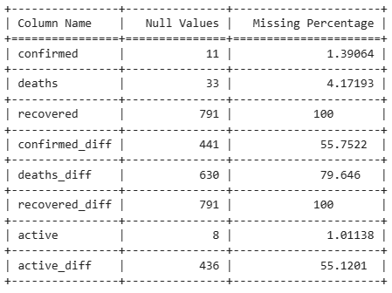

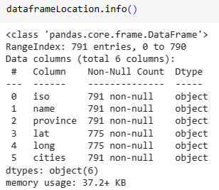

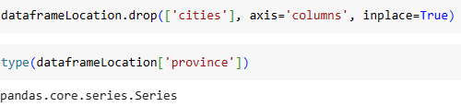
MISSING DATA INVESTIGATION
CREATION OF 2ND DATAFRAME FROM A COLUMN OF 1ST DATAFRAME
dataframeReports (missing info)
‘region’ →clustered dictionaries
IMPROVING DATA

Slide 5
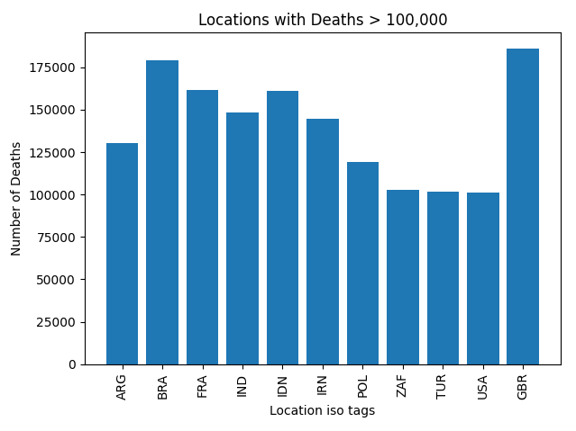
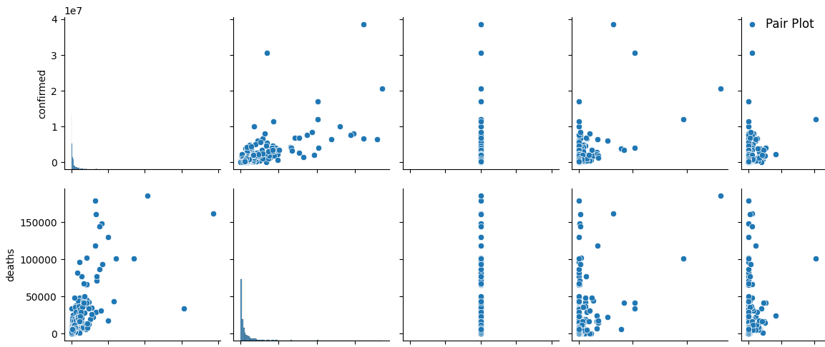
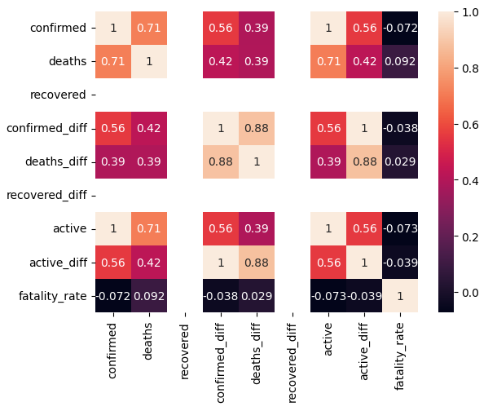
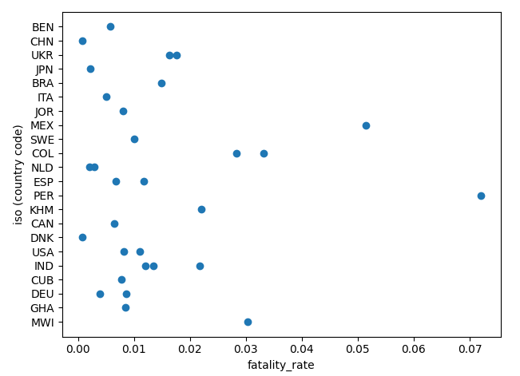
GRAPHICAL INVESTIGATION

Slide 6
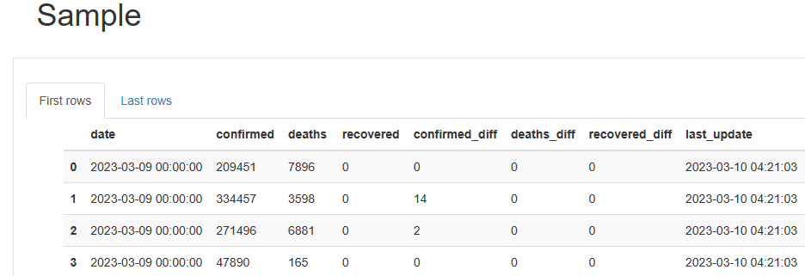
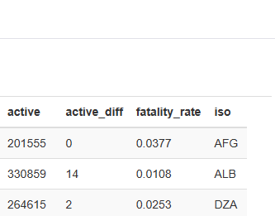
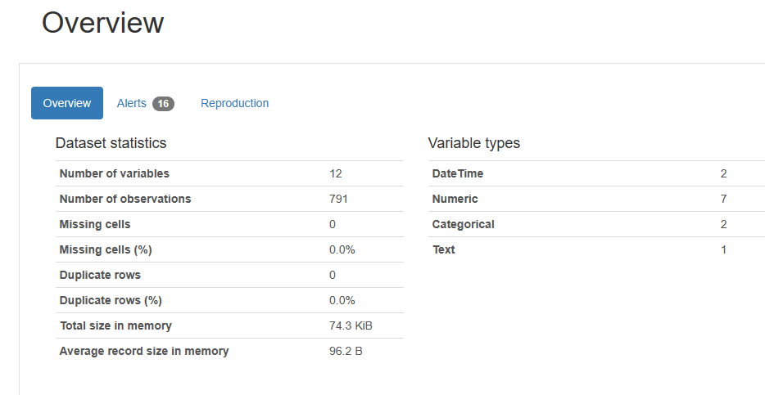
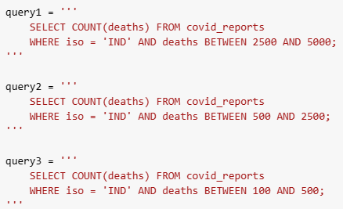


SQL INVESTIGATION
Countries: fatality rate (descending order of deaths)

Slide 7
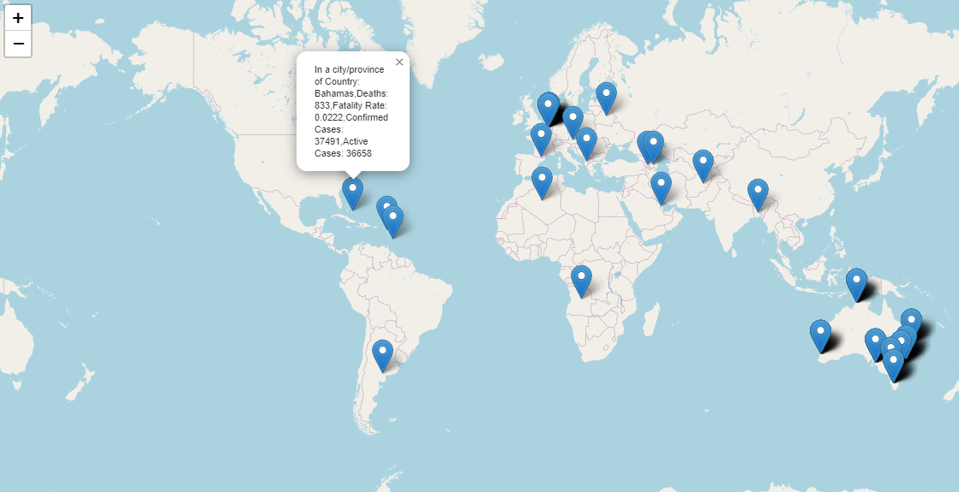
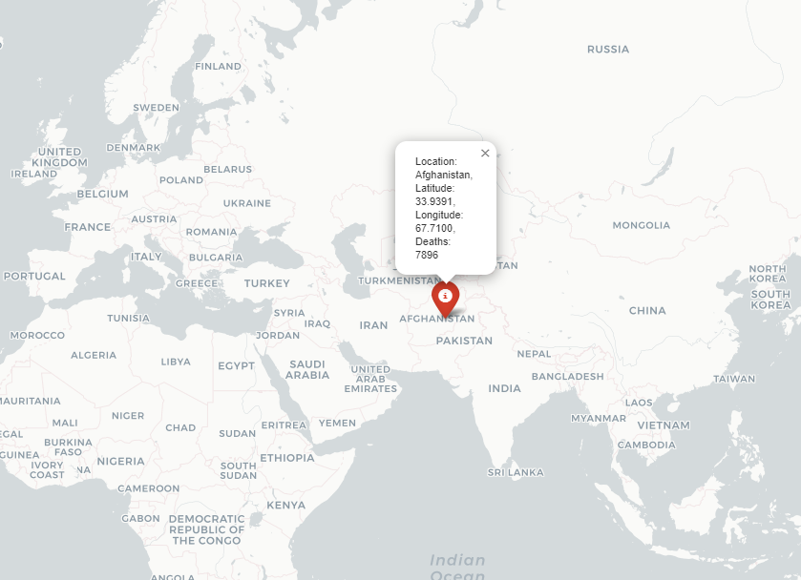
BELOW ARE LOCATIONS OF ANY COUNTRY/COUNTRIES
Based on the query: you can display 200 rows (city/province in any country) of information. Click on the marker to see the info.
Based on the query: you can display 1 row (city/province in any country) of information. Click on the marker to see the info.
SQL INVESTIGATION

Slide 8
References
Conclusions
Fatality rate is not exactly related to the number of deaths between countries.
higher confirmed and active cases leading to higher death
From SQL: we can get the number of occurrences of a range of deaths (for example we can find, how many times people between 5000 to 10,000 died in a particular country during covid-19 period)
Details can be popped up which contain the number of deaths, fatality rate, active cases, confirmed cases etc
Suggestions for Future works:
1. City and Province data can be converted to another two data frames
2. Date/time stamp was dropped as only one single entity for used for the entire dataset
Thank you
Requirements_couldnot install profiling etc.txt
Jupyter_colab_programInforVenuGopal…..doc
Mini_project_Colab Version.ipynb
Final DataScience mini_Project_8AUG...ipynb

